Slide 1
CMOS Detectors Characterization
By Isha Shukla
Electronics Engineer Co-op Student

Slide 2
Background
Charge Coupled Devices (CCDs) have long been the standard for imaging in astronomy.
However, the rapid advancement of Complementary Metal Oxide Semiconductor (CMOS) technology in the consumer market changed it.
CMOS sensors now dominate the market offering significant advantages in cost, availability and support.

Slide 3
Characteristics of a CMOS Detector
Linearity- Linearity is how sensors behave across different conditions. Particularly how a sensor behaves as it reaches saturation.
Charge Persistence- Charge persistence looks at if chargers linger within the sensor from frame to frame. Will a pixel’s value be impacted if it was saturated in the immediately preceding frame.
Gain- Gain is the conversion between from arbitrary ADU units to electrons. i.e a gain of 6e-/ADU means there are six electrons per ADU.

Slide 4
Salt and Pepper Noise- Salt and Pepper Noise also called Random Telegraph Noise (RTN) is discrete but random noise caused by manufacturing defects in silicon which create “traps” it results in more/less sensitive pixels than others.
Read Out Noise- This is the noise introduced through the readout circitry, mainly the preamplifier and ADC. Usually measured in e- RMS. Follows a skewed histogram distribution as opposed to CCD sensors which a follow a guassian one.
Dark Current- Dark current is the charge buildup on the sensor as a result of heat.

Slide 5
Quantum Efficiency- Quantum Efficiency (QE) is the measure of how many incident photons are converted into electrons in a sensor. If a sensor was exposed to 100 photons and produced 70 electrons it would have a QE of 70%.

Slide 6
What I did during my co-op term at NRC HAA
My work involved developing a Driver/Control Interface for CMOS Detectors.
The Driver is in the form of a comprehensive Python-based code suite, which allows Python applications to control and interact with the hardware via a C-based Software Development Kit (SDK).
Essentially created a bridge between the hardware (the CMOS detector) and the software environment we are working in (Python), enabling the detector to be controlled and used in a Python-based workflow.
It can be used to streamline and standardize the characterization process for various CMOS Detectors.

Slide 7
How did I go about it?
This project was already in progress by previous co-op student Aidan MacNichol.
I took over the project and continued working on it.
Initially started by replicating and improving Aidan’s experimental tests and control interface code with the SBIG STC-428 sCMOS camera from Diffraction limited.
Eventually moving onto doing all the same experiments and electronically interfacing with a brand new QHY268M/C PH camera.

Slide 8
How did I go about it? Continued..
Read hundreds of pages of various datasheets and manuals of the CMOS Detectors and the laboratory electronic equipments.
Used the information out of the datasheets and coded the control interface/driver in Python to interface or “talk” to the QHY268M/C PH camera.
Used ‘ctypes’ module in Python to load the QHYCCD DLL and call functions directly from this C-based library which interacts with the low-level functions provided by the QHYCCD Software Development Kit (SDK), such as camera initialization, setting parameters, capturing frames, etc.

Slide 9
How did I go about it? Continued yet again
Conducted experimental tests with my Python code using various over-the-bench electronic equipments like Optical Power Meters, Monochromators, Integrating Spheres etc.
Tried my best to understand the Reference Research Papers and make sense out of the graphs that I was getting out of the experiments.
After struggling with a bunch of broken micro-SD cards and annoying my fellow co-op student George by constantly asking if I could switch off the lights in the Integration lab for dark current testing.
I got progress with this project ☺

Slide 10
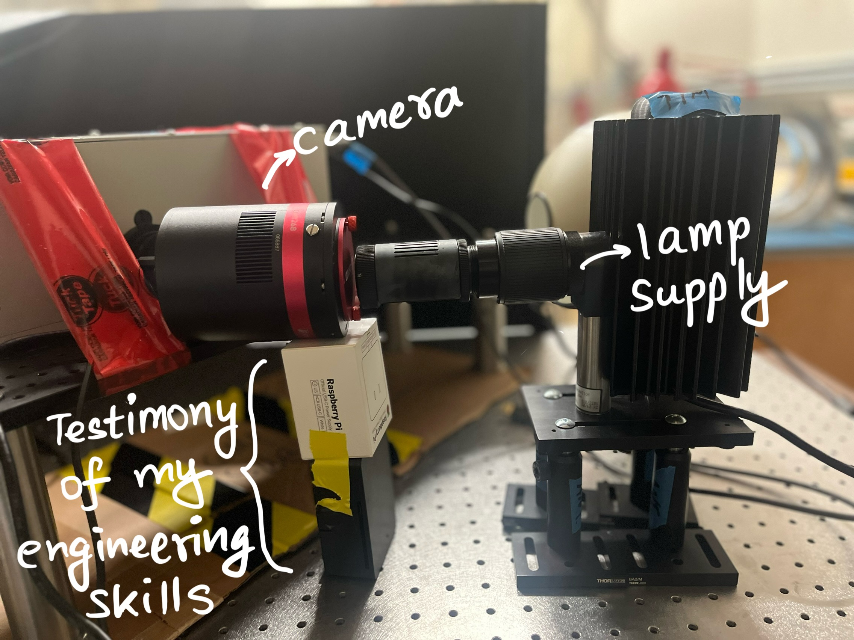

Here is a Typical Laboratory Setup of my experiments

Slide 11
How it brings value
The tool aims to facilitate integration of CMOS technology into astronomical research for evaluating their performance according to your needs for your cool telescope!
So that you don’t have to read through hundreds of pages of datasheets and deal with a lot of wires and electronics.

Slide 12
Methodologies

Slide 13
Linearity
Take 3 illuminated images while increasing the exposure time until the saturation point is reached.
2. Take 3 bias images before and after each series of illuminated images and stack them by median 3 sigma clipping and subtract it from all the illuminated images.
3. Use a central Region of Interest (ROI (4096x4096)) unbiased pixels.
4. The signal (ADU) is the mean of the three images stacked and plotted against exposure time.

Slide 14
Charge Persistence
Open the shutter for the camera for 10 seconds and let all the pixels saturate.
2. Then immediately close the shutter and take 1 second images consecutively.
3. Graph Average signal (ADU) vs time for the images taken.

Slide 15
Gain
Take N flats at the same exposure time but varying luminance
Take N darks at the same exposure time
Create Master Dark by taking the mean between N frames
For each flat subtract the master dark, then calculate the mean and variance of a nxn area of the image where it is "flattest" (avoid edges due to weird edge effects)
Plot Variance vs Mean and calculate the slope, this is the gain.

Slide 16
Salt and Pepper Noise
Take 100 bias frames.
2. Take a smaller region of interest (ROI (30x30 pixels)). This region will contain pixels with a much higher standard deviation.
3. Graph the value of the pixels in ADU for each of the 100 frames.

Slide 17
Read Out Noise
Take 100 bias frames (0s exposure shutter closed)
Perform 3-sigma clipping on each frame, replacing clipped values with the mean of the frame.
Stack them and take pixel wise mean to create a master bias.
Take 545 more bias frames.
Subtract the master bias from each of the 545 new bias frames.
For every pixel of coordinate (x,y) calculate: fractσ sqrt(2) between the N frames.
Repeat for every pixel in the frame. This results in an array containing the RON of each pixel

Slide 18
Dark Current
1. Take 10 dark frames (shutter closed) at a temperature and varying exposure times- 1 seconds, 10 seconds, 60 seconds, 120 seconds and 240 seconds.
2. Repeat the first step for five different sensor temperatures- 0°C,-5°C,-10°C,-15°C, -20°C.
3. Take Bias images and create master bias for all the temperatures using median 3 sigma clipping on individual biases then average each pixel together.
4. Subtract master bias from each individual frames.

Slide 19
Quantum Efficiency
Take exposures at around 80% of saturation across the visible light spectrum: 400nm, 500nm, 600nm and 700nm.
Take darks at same exposure time.
Repeat with photodiode Infront of lens recording the power output from the power meter.
The photodiode term is calculated as: Photodiode Term = (p*λ)/(h*c)
where: p = Power in Watts (From the photodiode) λ = Wavelength in nm h = Planks constant c = speed of light
The sensor term can be calculated as:
sensor Term = (ADU∗G)/t
where: ADU = Total counts of sensor in ADU G = gain of sensor t = exposure time
The final QE is calculated as:
QE = SensorTerm/PhotodiodeTerm

Slide 20
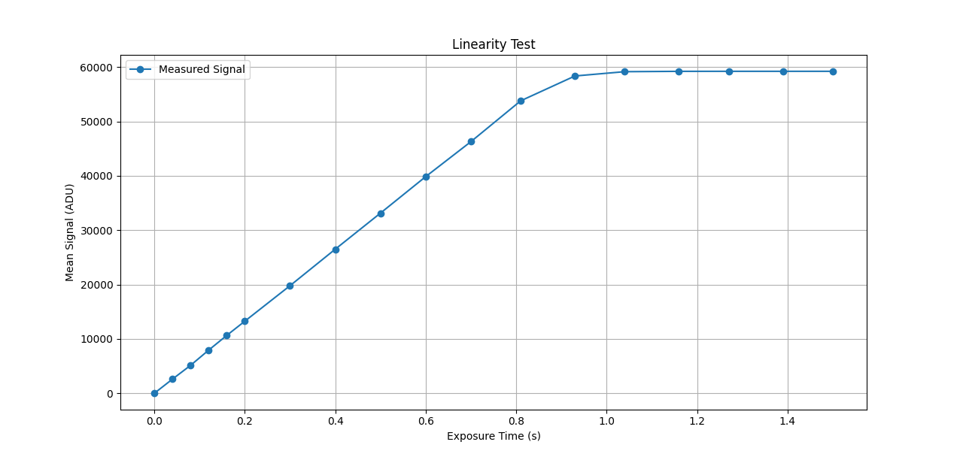
Results

Slide 21
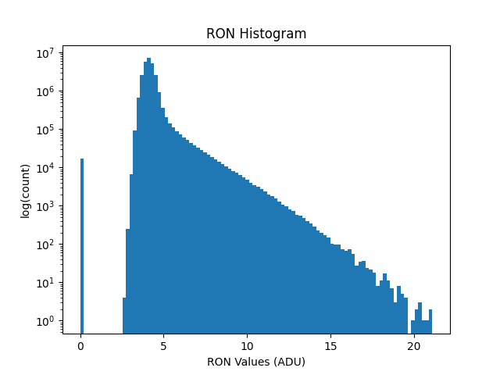
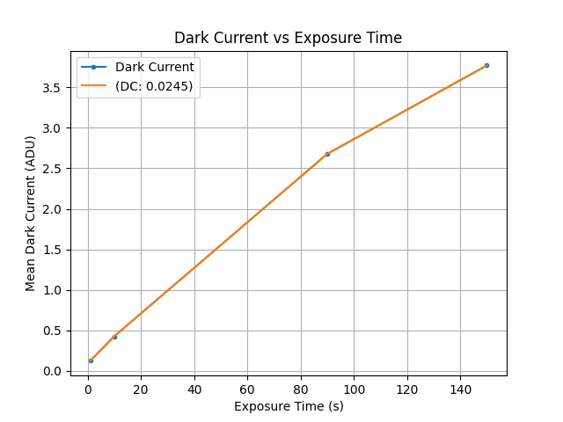

Slide 22
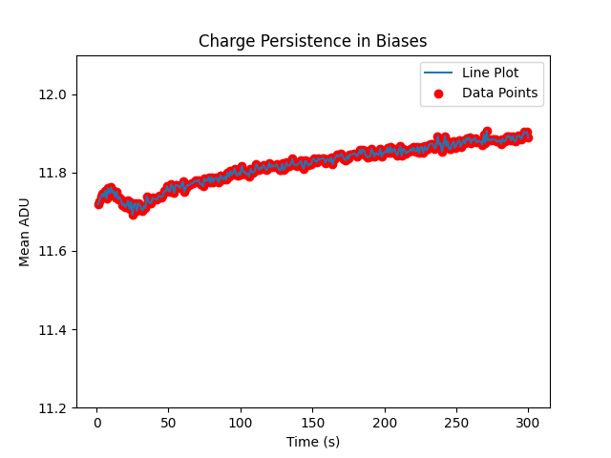
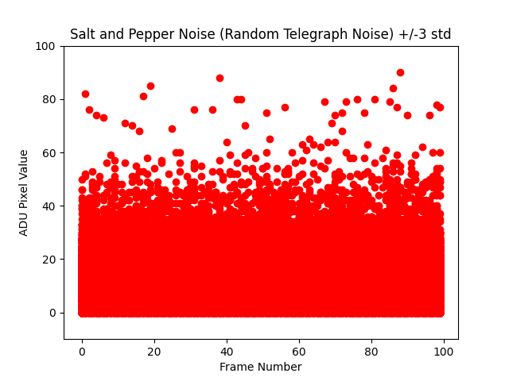

Slide 23
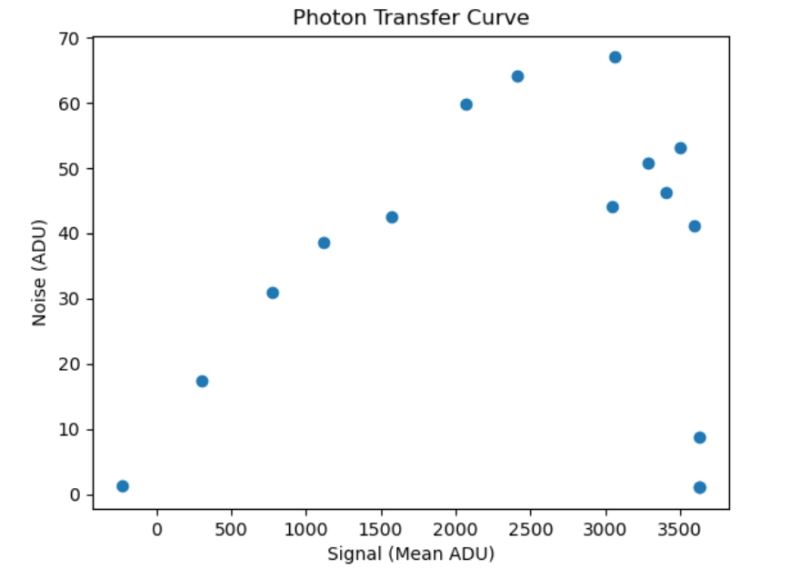

Slide 24
Next Steps for this Project
Some result graphs suggest that more extensive testing is needed within a few experiments like Salt and Pepper noise for the new camera, because of suspected internal processing on the frames taken.

Slide 25
Acknowledgments
Would like to thank my Supervisors Deb and Alexis for their constant support throughout my term at NRC HAA.
Would like to thank Tim for his valuable insights for times when I’d hit a roadblock.
Would like to thank my fellow co-op students that I was able to be friends with.
Would like to thank NRC HAA for this amazing summer co-op experience and a taste of the island life in Victoria.

